Slide 1
Noida Institute of Engineering and Technology, Greater Noida
Metrics For Technology Evaluation
Unit: 2
Sustainable Technologies
AOE0866
ANAMIKA SRIVASTAVA
Assistant Professor
CSE,CSER & M.Tech Integ.
CSE 8TH SEM

Slide 2
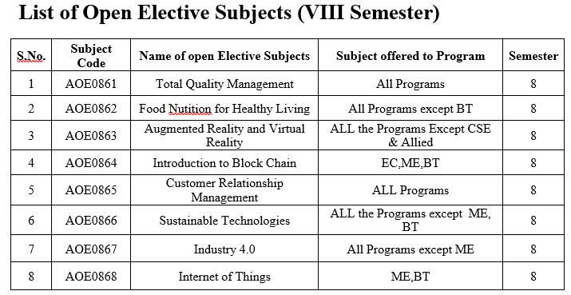
Evaluation Scheme

Slide 3
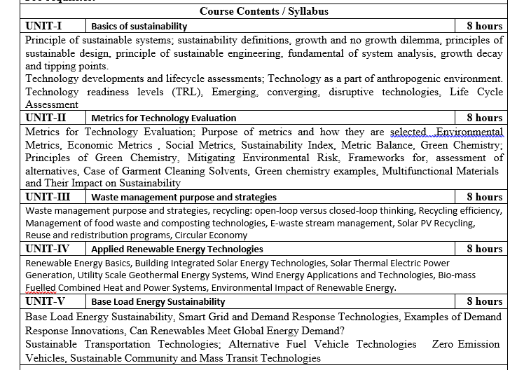
Syllabus

Slide 4
Branch wise Application
First, we will start with the internet which is very much important for our daily life and we cannot even imagine our life without the internet and it is the outcome of clever and creative algorithms. Numerous sites on the internet can operate and falsify this huge number of data only with the help of these algorithms.
The everyday electronic commerce activities are massively subject to our data, for example, credit or debit card numbers, passwords, OTPs, and many more. The centre technologies used incorporate public-key cryptocurrency and digital signatures which depend on mathematical algorithms.
Even an application that doesn't need algorithm content at the application level depends vigorously on the algorithm as the application relies upon hardware, GUI, networking, or object direction and all of these create a substantial use of algorithms.
There are some other vital use cases where the algorithm has been used such as if we watch any video on YouTube then next time we will get related-type advice as recommended videos for us.

Slide 5
Course Objective
Upon completion of this course, students will be able to do the following:
Analyze the asymptotic performance of algorithms.
Write rigorous correctness proofs for algorithms.
Demonstrate a familiarity with major algorithms and data structures.
Apply important algorithmic design paradigms and methods of analysis.
Synthesize efficient algorithms in common engineering design situations.

Slide 6
Course Outcome
At the end of the semester, the student will be able:
 | Description | Bloom’s Taxonomy
CO1 | To have knowledge of basic principles of algorithm design and Analysis, asymptotic notations and growth of functions for time and space complexity analysis and applying the same in different sorting algorithms | Knowledge, analysis And design
CO2 | To apply different problem-solving approaches for advanced data structures | Knowledge, analysis And apply
CO3 | To apply divide and conquer method for solving merge sort, quick sort, matrix multiplication and Greedy Algorithm for solving different Graph Problem. | Knowledge, analysis and Apply
CO4 | To analyze and apply different optimization techniques like dynamic programming, backtracking and Branch & Bound to solve the complex problems | Knowledge, Analysis And Apply
CO5 | To understand the advanced concepts like NP Completeness and Fast Fourier Transform, to analyze and apply String Matching, Approximation and Randomized Algorithms to solve the complex problems | Knowledge, Analysis and Apply

Slide 7
Program Outcome
At the end of the semester, the student will be able:
POs | Engineering Graduates will be able to
PO1 | Engineering Knowledge
PO2 | Problem Analysis
PO3 | Design & Development of solutions
PO4 | Conduct Investigation of complex problems
PO5 | Modern Tool Usage
PO6 | The Engineer and Society
PO7 | Environment and sustainability
PO8 | Ethics
PO9 | Individual & Team work
PO10 | Communication
PO11 | Project management and Finance
PO12 | Life Long Learning

Slide 8
CO-PO and PSO Mapping
Design and Analysis of Algorithm (kCS-502)
CO.K | PO1 | PO2 | PO3 | PO4 | PO5 | PO6 | PO7 | PO8 | PO9 | PO10 | PO11 | PO12
ACSE0401.1 | 3 | 3 | 3 | 3 | 2 | - | - | - | 2 | 2 | - | 3
ACSE0401.2 | 3 | 3 | 3 | 3 | 2 | 2 | - | 1 | 1 | 1 | - | 3
ACSE0401.3 | 3 | 3 | 2 | 3 | 3 | 2 | - | 2 | 1 | 1 | 2 | 3
ACSE0401.4 | 3 | 3 | 3 | 3 | 2 | 2 | - | 2 | 2 | 1 | 3 | 3
ACSE0401.5 | 2 | 2 | 2 | 2 | 2 | 2 | - | 2 | 1 | 1 | 1 | 2
Average | 2.8 | 2.8 | 2.6 | 2.8 | 2.2 | 1.6 | - | 1.8 | 1.4 | 1.2 | 1.2 | 2.8

Slide 9
Program Educational Objectives(PEOs)
PEO1: To have an excellent scientific and engineering breadth so as to
comprehend, analyze, design and provide sustainable solutions for
real-life problems using state-of-the-art technologies.
PEO2:To have a successful career in industries, to pursue higher studies or
to support enterpreneurial endeavors and to face global challenges.
PEO3:To have an effective communication skills, professional attitude,
ethical values and a desire to learn specific knowledge in emerging
trends, technologies for research, innovation and product
development and contribution to society.
PEO4: To have life-long learning for up-skilling and re-skilling for
successful professional career as engineer, scientist, enterpreneur
and bureaucrat for betterment of society

Slide 10
End Semester Question Paper Template
B TECH
(SEM-V) THEORY EXAMINATION 20__-20__
DESIGN AND ANALYSIS OF ALGORITHMS
Time: 3 Hours Total Marks: 100
Note: 1. Attempt all Sections. If require any missing data; then choose suitably.
SECTION A
Attempt all questions in brief. 2 x 10 = 20
Q.No. | Question | Marks | CO
1 |  | 2
2 |  | 2
. |  | .
10 |  | 2

Slide 11
End Semester Question Paper Templates
SECTION B
2. Attempt any three of the following: 3 x 10 = 30
SECTION C
3. Attempt any one part of the following: 1 x 10 = 10
Q.No. | Question | Marks | CO
1 |  | 10
2 |  | 10
. |  | .
5 |  | 10
Q.No. | Question | Marks | CO
1 |  | 10
2 |  | 10

Slide 12
End Semester Question Paper Templates
4. Attempt any one part of the following: 1 x 10 = 10
5. Attempt any one part of the following: 1 x 10 = 10
6. Attempt any one part of the following: 1 x 10 = 10
Q.No. | Question | Marks | CO
1 |  | 10
2 |  | 10
Q.No. | Question | Marks | CO
1 |  | 10
2 |  | 10
Q.No. | Question | Marks | CO
1 |  | 10
2 |  | 10

Slide 13
Unit Objective
In this lesson, we take a step further in the evaluation of technologies from the standpoint of environmental, economic, and social compatibility. Building upon the life cycle assessment concepts presented in Lesson 2, we will learn how to develop or select the metrics that would allow us to quantify the impacts and to decide on viability of technology projects. Metrics are important analytical tools when it comes to objective decisions, but they are not something predefined and ready to use. Metrics are meaningfully designed and tuned for a particular purpose, and it is the job of the evaluator to define that purpose prior to the analysis. This lesson overviews some of the methods that are used in environmental science and economics for technology evaluation. However, we are only scratching the surface here. Those areas of science are quite extensive and can fill whole books. So, while working through the basics and studying examples, be prepared to search further and specialize when you chose the metric set for your final course project down the road.
.

Slide 14
Purpose of metrics and how they are selected
One of the challenges in sustainability assessment of technologies or other elements of anthropogenic systems is designing meaningful and quantifiable metrics. Because sustainability frameworks are built on very diverse sets of environmental and economic values, there is difficulty in bringing them to common terms within a unified model.
When we ask the question "Is this process sustainable?", we often do not get a "yes/no" answer. Some parts of the system may benefit sustainable development, some parts may be in conflict with it, and some parts may be rather neutral or flexible. But how can we tell where we are on the scale of sustainability assessment? Further, if we do alter certain parts of the system, how much shift do we create towards sustainability goals? Can we measure the impact of those changes?

Slide 15
Purpose of metrics and how they are selected
All these questions prompted attempts to develop quantifiable metrics or indicators, which would allow researchers and policy makers to make more accurate comparisons between different paths of system development and take better justified decisions.
The existing methods for evaluating products and technologies in terms of environmental impact and sustainable development are numerous, and the scope of their applications and purposes is extremely wide. Metrics have been and continue to be developed by different agencies, companies, and researchers to address a variety of issues, which were often placed in different frameworks. As a result, those methods of assessment may use widely diverging rationale, terminology, and approaches, and often come up with contrasting results. Consistency and compatibility are most difficult issues!

Slide 16
Purpose of metrics and how they are selected
The following issues make metrics not a straightforward matter:
A metric may be composed of a single quantity or by a more complex set of measures (for example, indexes and "macro" metrics).
Metrics in science and technology evaluation are designed to measure a variety of activities, events, and phenomena—some simple and short-lived, others highly complex and durable along an extended time frame and therefore using different units and scales.
The absence of a unique and single building-block increases the role of subjective reasons for the construction and selection of metrics, which sometimes requires better formalization.
Designing comprehensive universal metrics, which would work as "magic crystal" for decision makers, is difficult, if at all possible, because different stakeholders care about different impacts. Most analytical approaches separate contexts and rather develop multi-metric frameworks for assessment. The table below lists some examples of metrics used for technology evaluation in various contexts. This list is not exhaustive, by any means, and in each assessment project metrics must be justified and modified for specific research purpose.

Slide 17
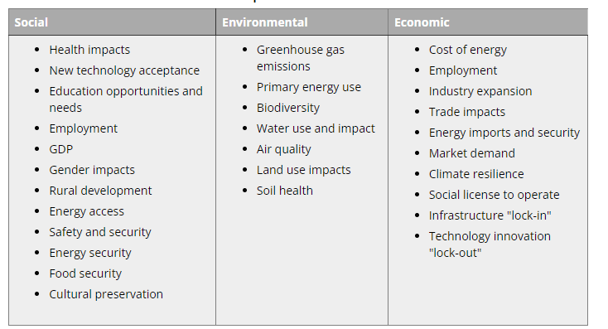
Purpose of metrics and how they are selected

Slide 18
Purpose of metrics and how they are selected
While working on this course, you should feel free to modify existing metrics or create new ones for the specific needs of your assessment. There are no "mandatory" criteria for evaluation - it all depends on the purpose and the message you try to deliver.
Lagging versus leading metrics
Lagging metrics are those that indicate what has already happened (past). For example:
amount of soil eroded
electricity cost per kWh
average annual temperature
battery efficiency measured
Leading metrics are those that indicate what may happen (future). For example:
deforestation rate
input / output ratio
wind direction and speed
Lagging metrics are mainly actual measures; leading metrics are usually indicators marking rates or trends

Slide 19
Purpose of metrics and how they are selected
Complexity levels of metrics
(In parentheses, some examples of metrics are given for the case of a wastewater treatment facility.)
Level 1 – Measure a technology’s level of compliance with regulations or its conformance with industrial performance standards (e.g., output concentration of hazardous chemicals versus EPA tolerance standards).
Level 2 – Measure the inputs, outputs, and performance of a technology during system operation (e.g., cost of purified water per gallon, amount of solid waste generated per year, treatment efficiency).
Level 3 – Evaluate the potential impact of the technology and associated operation on facility personnel, the surrounding environment, and communities (e.g., eutrophication, local air quality trends, carbon emission cost of facility operation).
Level 4 – Evaluate the lifecycle effects of the technology. This will involve Level 1-3 metrics as necessary to assess the impact of technology’s manufacturing, operation, and disassembly stages (e.g., amounts of raw materials consumed for

Slide 20
Purpose of metrics and how they are selected
D. Organic batteries provide better recallability
A typical battery consists of two electrodes - anode and cathode, electrolyte layer, separator, and current collectors. Most of traditional battery technologies use metals or metal oxides as electrode-active materials, and metals are not renewable resources. This study describes the use of organic materials as electrodes. The advantage of such organic-based batteries over Li-ion batteries in terms of sustainability is improved recallability, safety, adaptability to wet fabrication process, and extraction of starting material from less limited resources. One recently developed type of organic battery is based on organic radical polymers - "aliphatic or nonconjugated redox polymers with organic robust radical pendant groups as the redox site". The organic batteries have lower energy density compared to Li-ion technology, but this limitation is expected to be overcome in the near future.

Slide 21
Environmental metrics
Environmental metrics for scenarios measure cost, intensity, and recovery for energy, emissions, water, and waste.
CO2 Emissions The CO2 Emissions scenario metric calculates the total CO2 emissions for the scenario.
Emissions (Carbon) Intensity per GSF The Emissions (Carbon) Intensity per GSF scenario metric calculates the efficiency of emission (carbon) intensity per GSF for the scenario.
Emissions (Carbon) Intensity per Occupant The Emissions (Carbon) Intensity per Occupant scenario metric calculates the efficiency of emission (carbon) intensity per occupant for the scenario.
Energy Use The Energy Use scenario metric calculates the total energy use for the scenario.
Energy Use Intensity per GSF The Energy Use Intensity per GSF scenario metric calculates the efficiency of energy use intensity per GSF for the scenario.

Slide 22
Environmental metrics
Energy Use Intensity per Occupant The Energy Use Intensity per Occupant scenario metric calculates the efficiency of energy use intensity per occupant for the scenario.

Slide 23
Social media metrics
Social media involves the ultimate balancing act of the creative and the analytical. But if creativity is the intriguing icing on the cake, social media metrics are the essential ingredients to bringing the final dish to life.
There’s no one “magic” metric to measure. Marketers must depend on a healthy blend of multiple metrics to illustrate how social media impacts the entire business. And the social media metrics that will be crucial to your strategy and reporting will depend on your brand, business goals and strategy.
Just as social media is constantly in flux, so too are the metrics that prove to be most important in your larger strategy. In this article, we’ll walk through some of the key metrics social teams are focusing on now, and how to break down silos with your social media analytics and reporting strategy.

Slide 24
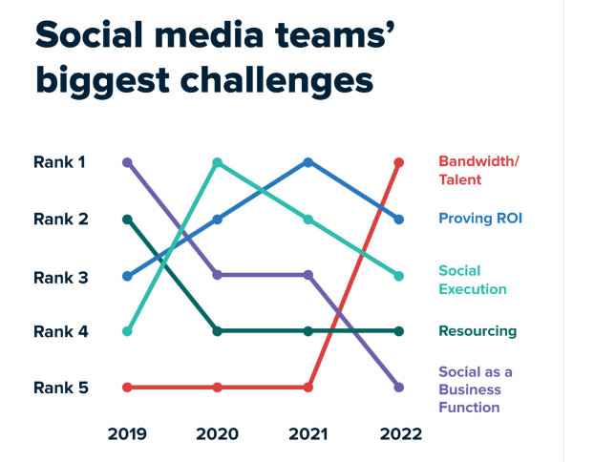
Social media metrics

Slide 25
Social media metrics
10 types of social media metrics marketers are prioritizing more
Your social media goals determine which metrics matter to you. But the metrics social pros are focusing on can help guide where to focus your efforts.
In a Q2 2023 Sprout pulse survey of 255 social marketers, we asked how much marketers are weighing certain metrics in 2023 vs. 2022. These are the metrics they indicated were being weighed more heavily this year.

Slide 26
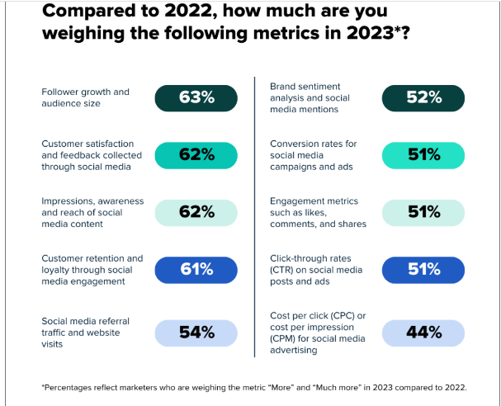
Social media metrics

Slide 27
Social media metrics
Follower growth and audience size
Customer satisfaction and feedback collected through social media
Awareness metrics (Impressions, awareness and reach of social media content)
Customer retention and loyalty through social media engagement
Social media referral traffic and website visits
Brand health metrics (sentiment analysis and social media mentions)
Conversion rates for social media campaigns and advertisements
Social media engagement metrics (likes, comments, and shares)
Click-through rates (CTR) on social media posts and ads
Paid metrics (Cost per click (CPC) or cost per impression (CPM) for social media advertising)

Slide 28
Sustainability index
A sustainability index is an instrument used to measure the sustainability of a business across environmental and social factors. It provides non-financial data that can tell investors and stakeholders how a company is managed in a day-to-day setting and the importance that they place on environmental stewardship and social responsibility.
There are dozens of different indexes that businesses can disclose to, each providing their own parameters and levels of credibility amongst the public. The Dow Jones Sustainability Index and FTSE4Good are the most popular in Europe, whilst the MSCI KLD 400 Social Index has a large representation in the US.
Sustainability indexes are becoming increasingly important, not only as a measure of risk for investors, but also as a measure of environmental impact. In the face of aggravating climate change, it is paramount that businesses place sustainability at the forefront of their management.
Being able to benchmark your company against others as well as being subject to pressures from the public is also a valuable driver of sustainability in business.

Slide 29
What is a sustainability index used for?
Sustainability indexes are primarily used by investors who are interested in introducing sustainable investments to their portfolios. The rise in this interest is in part due to the fact that a business’ sustainability performance is a strong indicator of future performance.
A study by HEC Paris titled “Do Investors Actually Value Sustainability Indices?” analysed the impact on companies that are listed on the Dow Jones Sustainability Index. Their findings showed that the listed businesses had a higher percentage of shares held by long-term investors, as well as higher visibility amongst financial analysts.

Slide 30
Metric Balance
Ideally, we would like to see the environmental, economic and social dimensions, and benefits of new technologies balanced. However, most real-life situations would gravitate differently towards those three dimensions. Results of the metric analysis need to be presented in a way that provides a clear and informative message to stakeholders and investors. Presented below are a couple of examples from sustainability assessments performed by government organizations.
The radial diagram in Figure 3.6 was presented by the National Renewable Energy Laboratory (NREL) to describe the sustainability profiles of several energy technologies. Six selected criteria plotted in 6 different directions in the form of a propeller provide an illustration of balance or lack of balance in system analysis. Note that each of the metrics is not directly comparable to others (like we saw in the case of the energy analysis, when all impacts are normalized to the same unit and scale). In this case, the scale for each metric needs to be defined independently versus boundary conditions (minimum and maximum values) so that it covers the appropriate range of evaluation.

Slide 31
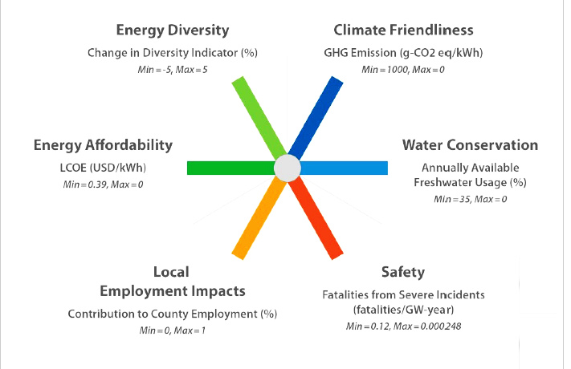
Metric Balance

Slide 32
Metric Balance
The diagram below (Figure 3.7.) presents another example of how different categories of metrics are balanced to characterize the sustainability profile of a city. From this representation, we can immediately recognize that the most problematic areas the city may want to address first are Emission and Waste, which create a critically bad impact, and Materials and Energy flows (the lowest: red and orange scores in the pie). At the same time, Cultural Engagement and Identity is the most attractive feature of the city (the highest: bright green score). We can also conclude just from a quick glance that the ecological part of this sustainability system is most suppressed, while the cultural part is probably most developed and sound. On the political and economic fronts, some of the impacts are in the favorable range, while others are down to satisfactory. This snapshot of the disbalance provides a tool for comparison when other systems (cities) are evaluated against the same metrics.

Slide 33
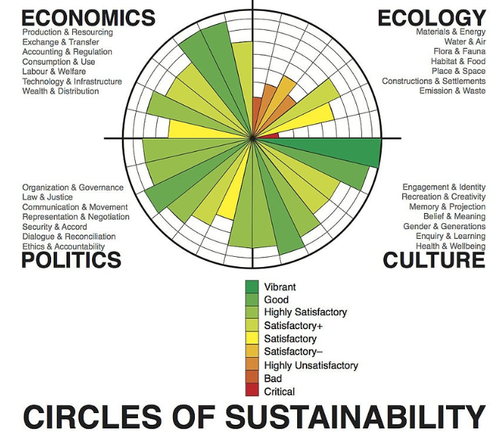
Metric Balance

Slide 34
Green chemistry
Sustainable and green chemistry in very simple terms is just a different way of thinking about how chemistry and chemical engineering can be done. Over the years different principles have been proposed that can be used when thinking about the design, development and implementation of chemical products and processes. These principles enable scientists and engineers to protect and benefit the economy, people and the planet by finding creative and innovative ways to reduce waste, conserve energy, and discover replacements for hazardous substances.
It’s important to note that the scope of these of green chemistry and engineering principles go beyond concerns over hazards from chemical toxicity and include energy conservation, waste reduction, and life cycle considerations such as the use of more sustainable or renewable feedstocks and designing for end of life or the final disposition of the product.
Green chemistry can also be defined through the use of metrics. While a unified set of metrics has not been established, many ways to quantify greener processes and products have been proposed. These metrics include ones for mass, energy, hazardous substance reduction or elimination, and life cycle environmental impacts.

Slide 35
Principles of green chemistry
Prevention It is better to prevent waste than to treat or clean up waste after it has been created.
Atom Economy Synthetic methods should be designed to maximize the incorporation of all materials used in the process into the final product.
Less Hazardous Chemical Syntheses Wherever practicable, synthetic methods should be designed to use and generate substances that possess little or no toxicity to human health and the environment.
Designing Safer Chemicals Chemical products should be designed to effect their desired function while minimizing their toxicity.
Safer Solvents and Auxiliaries The use of auxiliary substances (e.g., solvents, separation agents, etc.) should be made unnecessary wherever possible and innocuous when used.

Slide 36
Principles of green chemistry
Design for Energy Efficiency Energy requirements of chemical processes should be recognized for their environmental and economic impacts and should be minimized. If possible, synthetic methods should be conducted at ambient temperature and pressure.
Use of Renewable Feedstocks A raw material or feedstock should be renewable rather than depleting whenever technically and economically practicable.
Reduce Derivatives Unnecessary derivatization (use of blocking groups, protection/ deprotection, temporary modification of physical/chemical processes) should be minimized or avoided if possible, because such steps require additional reagents and can generate waste.
Catalysis Catalytic reagents (as selective as possible) are superior to stoichiometric reagents.
Design for Degradation Chemical products should be designed so that at the end of their function they break down into innocuous degradation products and do not persist in the environment.

Slide 37
Principles of green chemistry
Real-time analysis for Pollution Prevention Analytical methodologies need to be further developed to allow for real-time, in-process monitoring and control prior to the formation of hazardous substances.
Inherently Safer Chemistry for Accident Prevention Substances and the form of a substance used in a chemical process should be chosen to minimize the potential for chemical accidents, including releases, explosions, and fires.

Slide 38
Mitigating environmental risk
Environmental management accounting can assist in improving decisions relating to cost allocation, capital budgeting and process design.
Environmental risk, on the other hand, has various definitions about how ‘risk’ and related terms should be defined. For the purpose of this discussion environmental risk is defined as the probability of occurrence of a particular adverse effect on human health or the environment as a result of exposure to an environmental hazard. An environmental hazard may be a hazardous chemical in the environment, a natural hazard, or a hazardous technology^{[2]}. Environmental risk assessment refers to any formal or informal scientific procedure used to produce a quantitative estimate of environmental risk. The process of risk assessment, identified by many^{[2-4]} involves the following four steps:

Slide 39
Mitigating environmental risk
Hazard identification: determining whether a particular chemical causes a particular health effect.
Probability of occurrence: determining the relationship between magnitude of exposure and probability the health effect will occur.
Exposure assessment or evaluating consequences: determining the extent of exposure before or after application of regulatory controls.
Risk assessment: describing the nature and often the magnitude of risk, including attendant uncertainty

Slide 40
Mitigating environmental risk
Risk and liability assessment of a company addresses the assessment of environmental-related risk and financial liabilities. Management accountants can play a crucial role in estimating the potential cost of these contingent liabilities to the firm, the likelihood of their occurrence (risk factor), as well as their appropriate allocations^{[4]}.
Environmental management accounting (EMA) is different from conventional accounting as the former ‘separately identify, measure, analyse and interpret the information about environmental aspects of company activity’ – a distinction that is not clear in conventional accounting^{[5]}. Companies further divide EMA into monetary environmental management accounting (MEMA) and physical environmental management accounting (PEMA). MEMA deals with past, present or future stock and flows, expressed in monetary terms whereas PEMA deals with past, present or future material and energy amounts (in physical terms) that have an impact on the environment^{[5]}.

Slide 41
Frameworks for assessment of alternatives
Alternatives assessment or alternatives analysis is a problem-solving approach used in environmental design, technology, and policy. It aims to minimize environmental harm by comparing multiple potential solutions in the context of a specific problem, design goal, or policy objective. It is intended to inform decision-making in situations with many possible courses of action, a wide range of variables to consider, and significant degrees of uncertainty. Alternatives assessment was originally developed as a robust way to guide precautionary action and avoid paralysis by analysis; authors such as O'Brien have presented alternatives assessment as an approach that is complementary to risk assessment, the dominant decision-making approach in environmental policy.^{[1]} Likewise, Ashford has described the similar concept of technology options analysis as a way to generate innovative solutions to the problems of industrial pollution more effectively than through risk-based regulation.^{[2][3]}
Alternatives assessment is practiced in a variety of settings, including but not limited to green chemistry, sustainable design, supply-chain chemicals management, and chemicals policy.^{[4]} One prominent application area for alternatives assessment is the substitution of hazardous chemicals with safer alternatives, also known as chemical alternatives assessment.^{[5]}

Slide 42
Frameworks for assessment of alternatives
Methodology[edit]
Generally, alternatives assessment involves considering a number of possible options to achieve a specific objective, and applying a principled comparative analysis. The objective is usually to improve the environmental performance or safety of a specific product, material, process, or other activity. Potential alternatives considered in the analysis may include different chemical substances, materials, technologies, methods of use, or even extensive redesign to enable new ways of achieving the objective while avoiding the problem. Understanding the consequences of each available option is central to the process and goals of alternatives assessment, because this helps avoid decisions that substitute one problem with another (unknown) problem. The comparative analysis can involve any number of criteria for evaluating options, and these are typically focused on environmental health and sustainability.^{[6]}
There is no single protocol that dictates how options should be identified, evaluated, and compared in an alternatives assessment. Rather, a number of different alternatives assessment frameworks exist, which serve to structure decision-making and to enable systematic consideration of the key factors. Jacobs and colleagues identify six major components of alternatives assessment: evaluation of hazard, exposure, life cycle impacts, technical feasibility, and economic feasibility; and an overall decision-making strategy.^{[7]}
One major framework, the Lowell Center for Sustainable Production Alternatives Assessment Framework,^{[6]} conceives of alternatives assessment very broadly, as a reflexive problem-solving process that recognizes the social and technical complexity of environmental problems. It emphasizes aspects such as stakeholder participation, transparency of the process, and open discussion of values in decision-making. Most other frameworks are more narrow and primarily focused on technical aspects.^{[7]}

Slide 43
Frameworks for assessment of alternatives
Chemical alternatives assessment[edit]
Chemical alternatives assessment (or substitution of hazardous chemicals) is the use of alternatives assessment for finding safer and environmentally preferable design options to reduce or eliminate the use of hazardous chemical substances. Safer alternatives to hazardous chemicals may simply be other chemical substances, or may involve deeper changes in material or product design.^{[8][9]} Chemical alternatives assessment aims to provide the basis for well-informed decision-making by thoroughly characterizing chemicals and materials (and other design options) across a wide range of environmental and health impact categories. The rationale for this is to avoid shifting environmental health burdens from one category of impacts to another (e.g., substituting a carcinogenic chemical with a neurotoxic one), and to minimize the unintended consequences of decisions made under conditions of uncertainty and ignorance—in other words, to prevent "regrettable substitutions", where an alternative appeared better based on limited knowledge, but turned out to be worse or equally bad.^{[10]}

Slide 44
Case of garment cleaning solvent
The case study presented below exemplifies the application of a range of criteria to the process in the dry cleaner industry. This kind of analysis can help decision-making process in the green chemistry context.
(Source: UCLA Sustainable Technology & Policy Program, 2011)
Baseline and alternatives
The existing process of garment cleaning utilizes chlorine-based solvent technology, which is not sufficiently benign. This case study examines a few alternative technologies, which aim at making it a greener process. Table 4.3 below lists the alternatives under consideration.

Slide 45
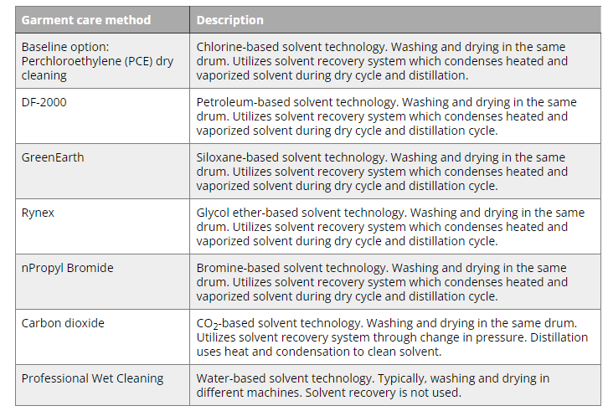
Case of garment cleaning solvent

Slide 46
Case of garment cleaning solvent
Criteria weighting
Criteria weighting was based on stakeholder elicitation. Four stakeholder groups were considered by the authors: Environmental Non-governmental Organizations (NGO), Industry, Policymakers, and Consumers. The elicitation process was also designed to obtain stakeholder reactions to the criteria; for example, whether any relevant criteria have been left out. During interviews, stakeholder representatives were asked to rank the major criteria on the 100 point scale, and the average weight of that criterion was obtained by averaging scores over all interviews. The list of relative (percentage) weights of all major evaluation criteria, as voted by different stakeholders, is presented in Table 4.4.

Slide 47
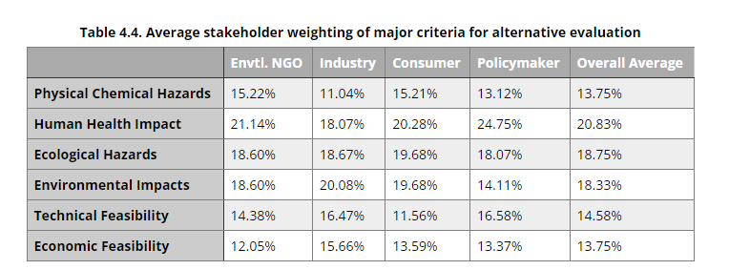
Case of garment cleaning solvent

Slide 48
Green chemistry example
The US EPA and the ACS Green Chemistry Institute® have played a major role in promoting research and education in pollution prevention and the reduction of toxics over the past three decades.
Governments and scientific communities throughout the world recognize that the practice of green chemistry and engineering not only leads to a cleaner and more sustainable earth, but also is economically beneficial with many positive social impacts. These benefits encourage businesses and governments to support the development of sustainable products and processes. The United States, desiring to reward and celebrate significant achievements in Green Chemistry, has given out an annual award since 1996, the Presidential Green Chemistry Challenge Award.
Examples of green chemistry accomplishments listed below illustrate how green chemistry impacts a wide array of fields, from pharmaceuticals to housewares, and offer a pathway to a better world.

Slide 49
Multifunctional material and their impact on sustainability
Multifunctional materials are the materials that perform multiple functions in a system due to their specific properties. Multifunctional materials can be both naturally existing and specially engineered.
For example, some traditional materials that provide, for instance, high mechanical strength can be modified at the nanoscale to attain other properties such as energy absorption, self-healing, etc. The applications of such new "smart" materials include energy, medicine, nanoelectronics, aerospace, defense, semiconductor, and other industries.
Numerous examples of multifunctional materials can be found in nature. Bio-materials routinely contain sensing, healing, actuation, and other functions built into the primary structures of an organism. For example, the human skin consists of many layers of cells, each of which contains oil and perspiration glands, sensory receptors, hair follicles, blood vessels, and other components with functions other than providing the basic structure and protection for the internal organs. Through biological evolution, these structures were seamlessly integrated into the body to serve their functions (Nemat-Naser et al., 2005).

Slide 50
Multifunctional material and their impact on sustainability
The ability for materials to respond to their environment in a useful manner has broad technological impact. Such "smart" systems are being developed in which material properties (such as optical, electrical, or mechanical characteristics) respond to external stimuli. Materials of this kind have tremendous potential to impact new system performance by reducing size, weight, cost, power consumption, and complexity while improving efficiency, safety, and versatility. The multifunctionality of materials often occurs at scales from nano through macro and on various temporal and compositional levels (Nemat-Nasser et al., 2005).
Innovative advanced materials make a direct and positive impact on economic growth, the environment, and quality of life. They allow for improved processes and products and create several avenues to increasing sustainability.

Slide 51
Multifunctional material and their impact on sustainability
Note the following areas of impact:
reducing environmental effects
increasing efficiency of processes
lightening the weight of products
lowering power consumption
reducing system size
reducing system weight
reducing system cost
reducing complexity
increasing safety
increasing fuel flexibility
increasing versatility
Most of these impacts may result in higher efficiency of the system and cost savings.

Slide 52
Multifunctional material and their impact on sustainability
Examples of advanced materials studies
The following are several examples of sustainable solutions through improved materials chemistry or using alternative innovative materials.
A. Power-generating structural composites
"Researchers at ITN Energy Systems and SRI International have integrated a power-generating function into ﬁber reinforced composites. Individual ﬁbers are coated with cathodic, electrolytic, and anodic layers to create a battery. The use of the surface area of ﬁbers as opposed to that of a foil in a thin ﬁlm battery allows greater energy outputs, measured on the order of 50 Wh/kg in a carbon ﬁber reinforced epoxy laminate. These batteries may be deposited on various substrates, including glass, carbon, and metallic ﬁbers."

Slide 53
Multifunctional material and their impact on sustainability
B. Thermostructural materials for gas turbines
Gas turbines are a core technology in aero-propulsion and industrial power generation. Technological progress in this area depends on advances in thermostructural materials. The requirements to reduce emissions, increase fuel flexibility, and resist environmental attack call for development of new material systems with multifunctional properties. University of California Santa Barbara researchers employ a holistic approach that embraces and integrates all critical aspects of materials technology, including alloys, coatings, and composites, processing, and simulations to create the thermostructural materials that combine mechanical strength and exceptional thermal stability. Materials issues relevant to the high-pressure turbine include higher temperature single crystal alloys that act in concert with coatings, advanced bond coat alloys for environmental protection with improved thermochemical and thermomechanical compatibility with the load-bearing alloy, and thermal barrier oxides with new compositions that enhance temperature capabilities. Ceramic matrix composites (CMCs) and associated environmental barrier coatings are also incorporated in next generation engines, especially for combustors.

Slide 54
Multifunctional material and their impact on sustainability
C. Nanoparticle assembly using DNA strands
"Scientists at the U.S. Department of Energy's Brookhaven National Laboratory have developed a general approach for combining different types of nanoparticles to produce large-scale composite materials with special properties. The approach takes advantage of the attractive pairing of complementary strands of synthetic DNA—based on the molecule that carries the genetic code in its sequence of matched bases known by the letters A, T, G, and C. After coating the nanoparticles with a chemically standardized "construction platform" and adding extender molecules to which DNA can easily bind, the scientists attach complementary lab-designed DNA strands to the two different kinds of nanoparticles they want to link up. The natural pairing of the matching strands then "self-assembles" the particles into a three-dimensional array consisting of billions of particles. Varying the length of the DNA linkers, their surface density on particles, and other factors gives scientists the ability to control and optimize different types of newly formed materials and their properties."
Source: Brookhaven National Laboratory

Slide 55
Multifunctional material and their impact on sustainability
D. Organic batteries provide better recallability
A typical battery consists of two electrodes - anode and cathode, electrolyte layer, separator, and current collectors. Most of traditional battery technologies use metals or metal oxides as electrode-active materials, and metals are not renewable resources. This study describes the use of organic materials as electrodes. The advantage of such organic-based batteries over Li-ion batteries in terms of sustainability is improved recallability, safety, adaptability to wet fabrication process, and extraction of starting material from less limited resources. One recently developed type of organic battery is based on organic radical polymers - "aliphatic or nonconjugated redox polymers with organic robust radical pendant groups as the redox site". The organic batteries have lower energy density compared to Li-ion technology, but this limitation is expected to be overcome in the near future.

Slide 56
MCQS
Which of the following is the task of project indicators: a) help in assessment of status of ongoing project b) track potential risk c) help in assessment of status of ongoing project & track potential risk d) none of the mentioned
Which of the following does not affect the software quality and organizational performance? a) Market b) Product c) Technology d) People
The intent of project metrics is: a) minimization of development schedule b) for strategic purposes c) assessing project quality on ongoing basis d) minimization of development schedule and assessing project quality on ongoing basis

Slide 57
MCQS
4. Which of the following is not a direct measure of SE process? a) Efficiency b) Cost c) Effort Applied d) All of the mentioned
5. Which of the following is an indirect measure of product? a) Quality b) Complexity c) Reliability d) All of the Mentioned
6. In size oriented metrics, metrics are developed based on the ___________________ a) number of Functions b) number of user inputs c) number of lines of code d) amount of memory usage

Slide 58
MCQS
7.Which of the following is not an information domain required for determining function point in FPA ? a) Number of user Input b) Number of user Inquiries c) Number of external Interfaces d) Number of errors
8. Usability can be measured in terms of: a) Intellectual skill to learn the system b) Time required to become moderately efficient in system usage c) Net increase in productivity d) All of the mentioned View Answer
9. A graphical technique for finding if changes and variation in metrics data are meaningful is known as a) DRE (Defect Removal Efficiency) b) Function points analysis c) Control Chart d) All of the mentioned

Slide 59
MCQS
10. Defects removal efficiency (DRE)depends on: a) E – errors found before software delivery b) D – defects found after delivery to user c) Both E and D d) Varies with project

Slide 60
THANKYOU

